Slide 1



PhoSim-NIRCam
Magnus Jacob Magnusson
Mentor: Dr. Eiichi Egami
University of Arizona, Steward Observatory
23 April 2022
Notes:
Notes from Dr. Egami:

Slide 2
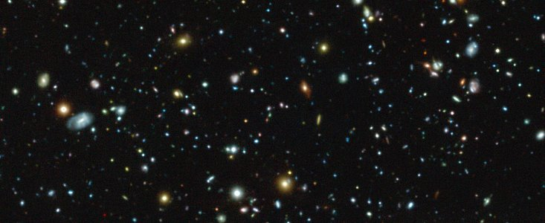
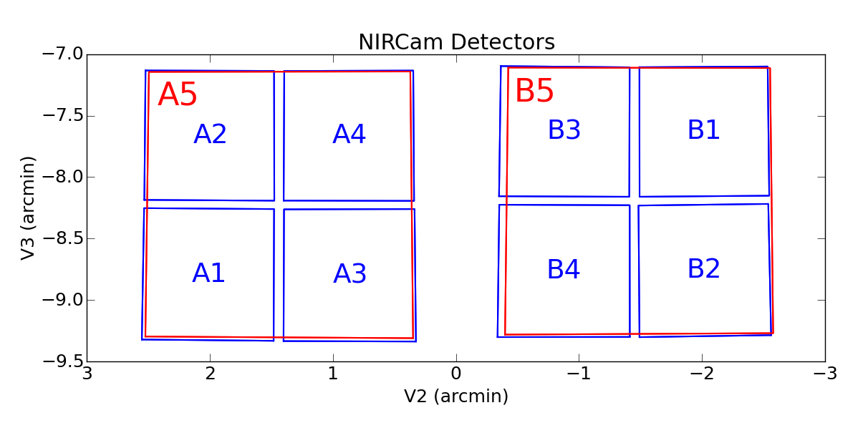
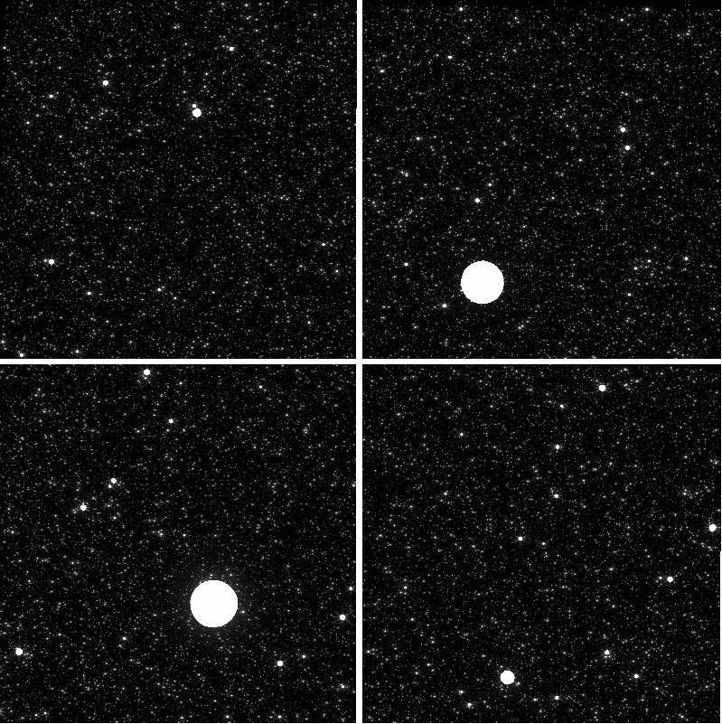
JWST-NIRCam
Image credit: ESO
JWST
James-Webb Space Telescope
Successor to Hubble
6.25 times the collecting area
NIRCam
Near Infrared Camera
Detector on JWST
Exoplanets, brown dwarf formation, and high redshift observations.
Image credit: NASA/STScI
Notes:
Note organization of NIRCam on focal plane array

Slide 3
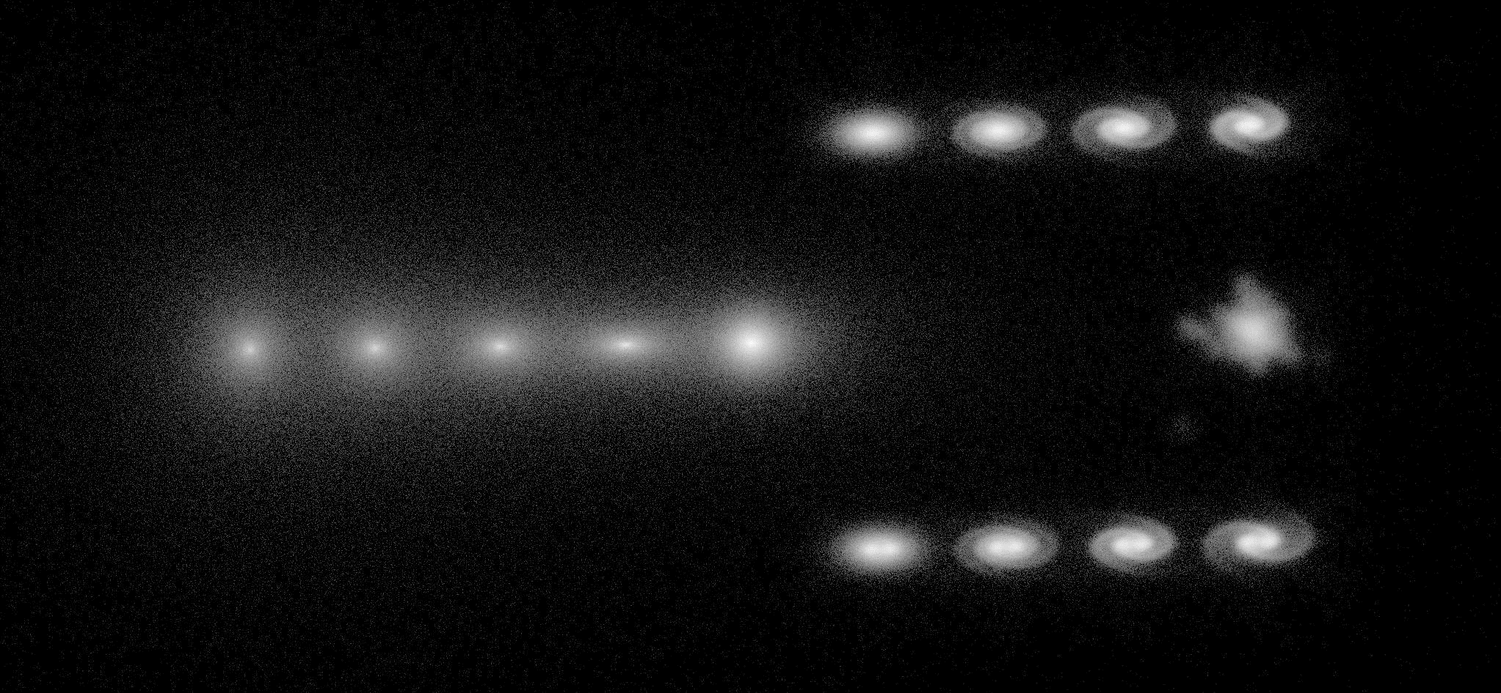
What Makes PhoSim Unique?
Why do we need to simulate these images?
Keyword: Monte Carlo Photon Ray-Tracing - Tracking Light Paths
Notes:
3 simulators: PhoSim, Guitarra and Mirage

Slide 4
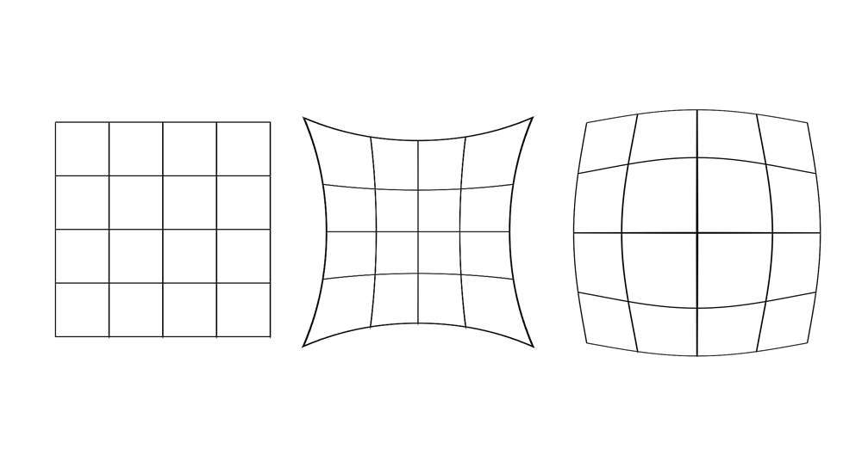
PhoSim Tuning
Image credit: NASA/STScI
Focal Plane Array
  May be misaligned
  Two modules for safety
Geometric Distortion
  Optical System can offset apparent position
  Polynomial Fitting
Image credit: Wikipedia
Notes:
Potentially show Alignment before and after fine tuning (Guitarra Phosim Plots from John Meeting)

Slide 5
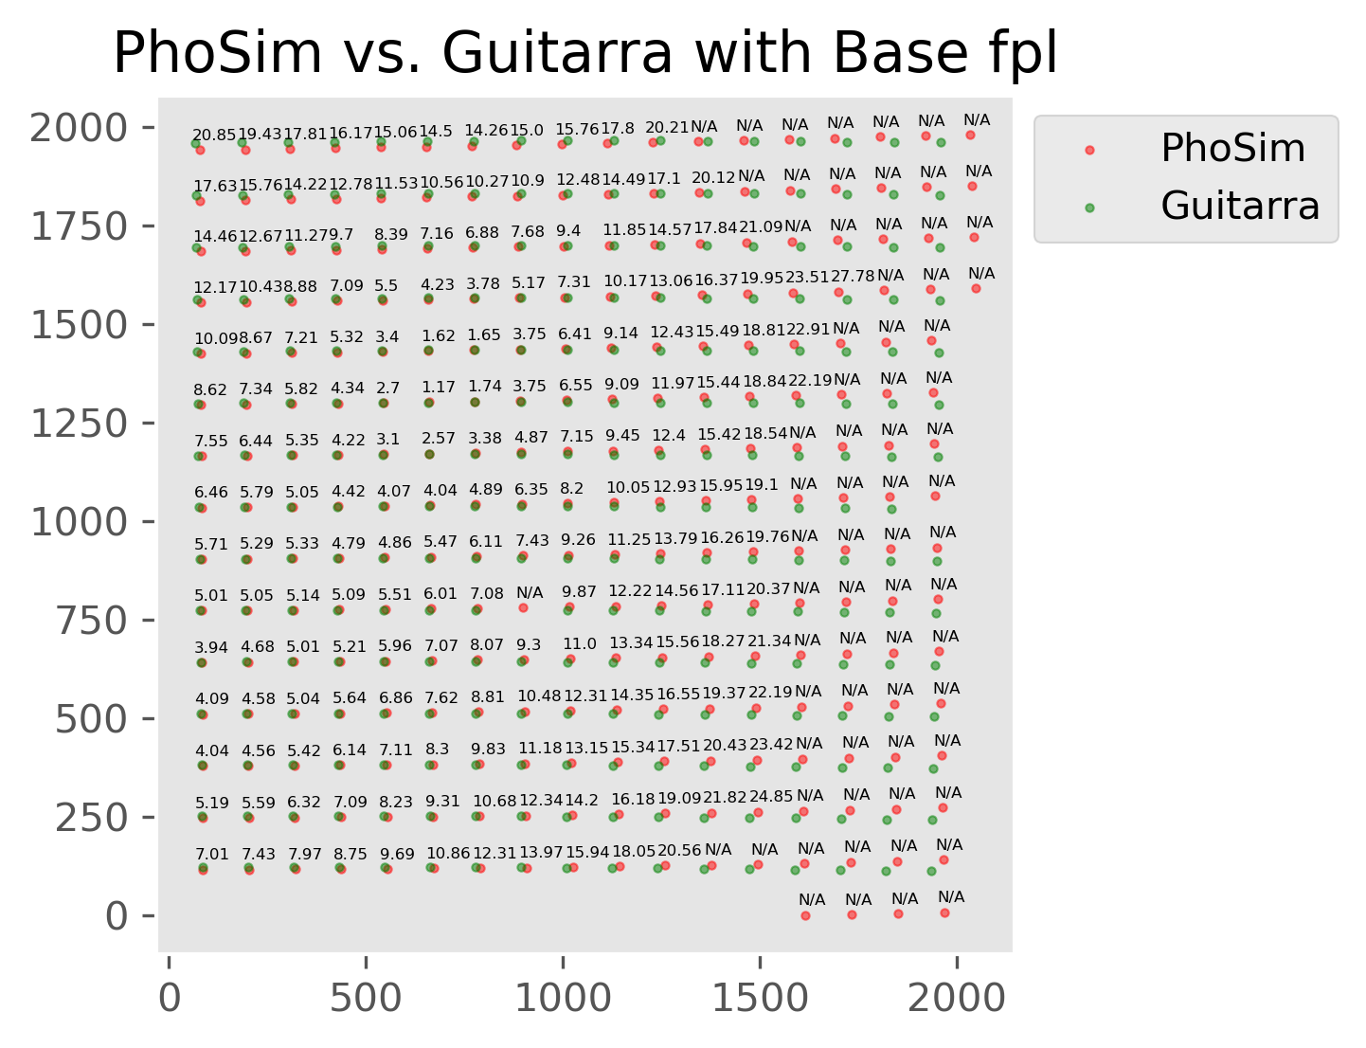
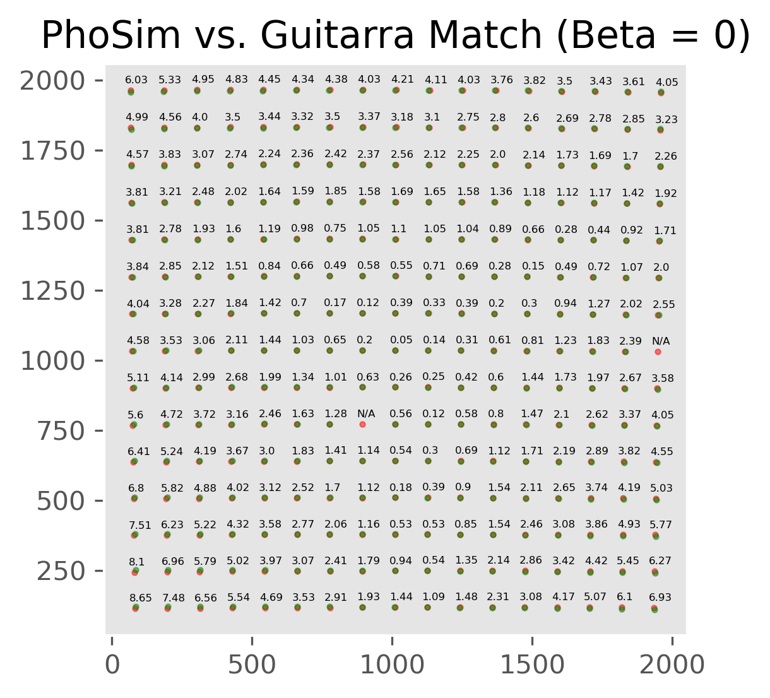
Notes:
Potentially show Alignment before and after fine tuning (Guitarra Phosim Plots from John Meeting)

Slide 6
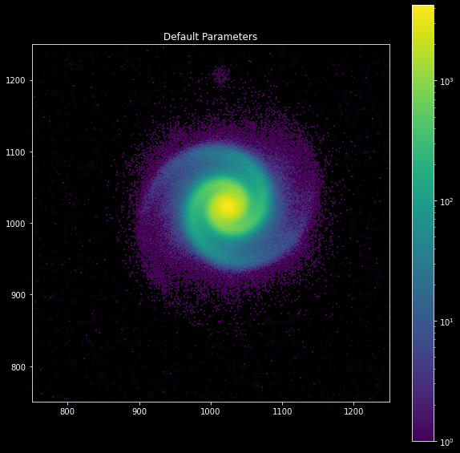
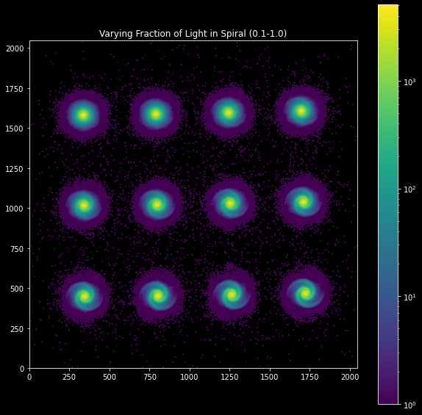
Complicated Structure

Slide 7

Conclusions and Future
I adjusted the focal plane layout and developed tools for writing complex catalogs
Short wavelength chip alignment harder
Polynomial fitting currently difficult due to PhoSim header output
Image credit: NASA/STScI
Image credit: Wikipedia

Slide 8
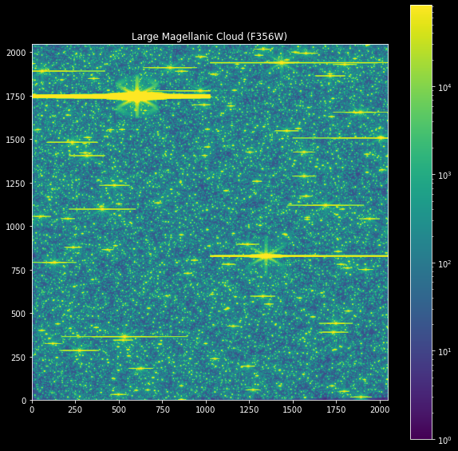
The LMC
(Large Magellanic Cloud)
Satellite Galaxy to the Milky Way
Homogenous distribution of stars with well known positions
A perfect candidate for geometric distortion calibration
Horizontal chip spillover typical of CCDs, not CMOS detectors (Corrected in recent PhoSim Update)
Notes:
3 Color image

Slide 9

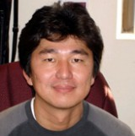
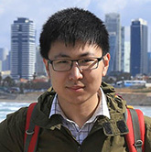

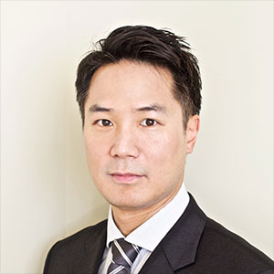
Acknowledgements
Eiichi Egami
Mentor
Fengwu Sun
UA Graduate Student
John Peterson
PhoSim Developer
Tony Sohn
STScI Contact

Slide 10
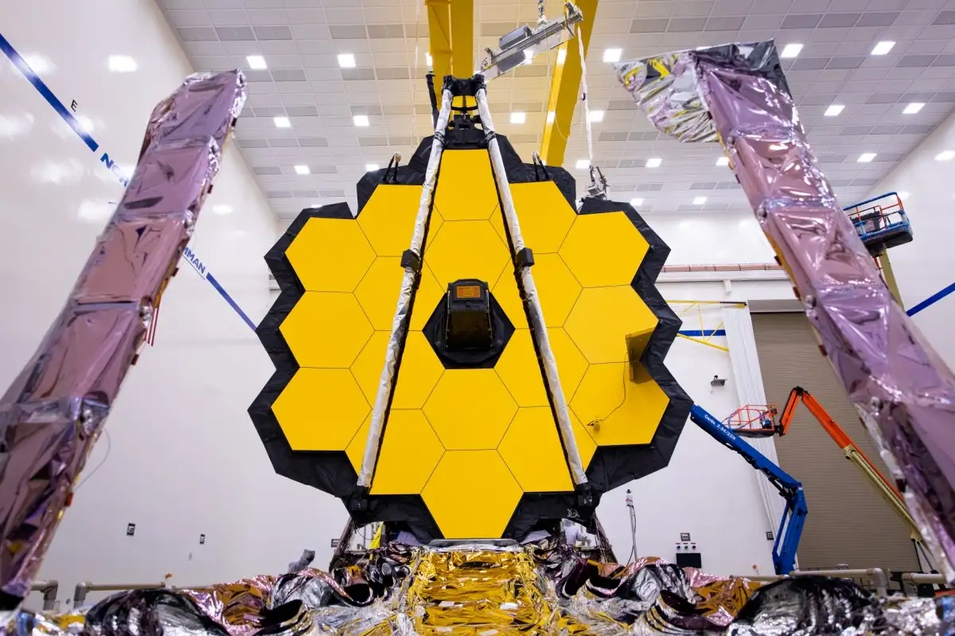
Thank You
Image credit: NASA
Magnus Jacob Magnusson
magnussonm0@email.arizona.edu

